Slide 1
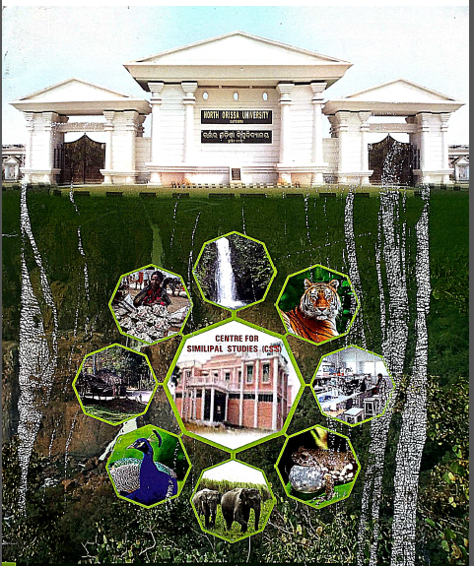
CENTRE FOR SIMILIPAL STUDIES

Slide 2
Genesis
The Centre for Similipal Studies (CSS) of MSCB University (Erstwhile North Orissa University) was established in the year 2005 with a view to carry out research, documentation and field studies related to Similipal Biosphere.
A Core Committee was constituted to frame the guidelines for the Centre vide Syndicate Resolution no.12 (d) dated 9.2.2005 and No.4 (d) dated 18.2.2005. The Core Committee consisted of the following members:
Chairman-Vice- Chancellor Prof. S. Nanda
Members-
Director, STR, Baripada
Prof. Rita Ray, Professor of Sociology, Utkal University
Prof. P. K. Das, Professor of Anthropology, Utkal University
Dr Ajit Patnaik, Chief Executive, Chilika Development Authority
Dr K. K. Basa, Director, Indira Gandhi Rashtriya Manav Sangrahalaya, Bhopal
Dr S. K. Dutta, Professor of Zoology, NOU
Dr U. B. Mohapatra, Professor of Botany, NOU
Convenor- Registrar, NOU

Slide 3
Current team
Director: Prof. Hemanta Kumar Sahu, Department of Zoology, MSCBU
Associate Directors: Dr B. Rath, Department of Biotechnology, MSCBU
Dr S. C. Sahu, Department of Botany, MSCBU
Dr S. Rath, Department of Wildlife and Biodiversity Conservation, MSCBU

Slide 4
OBJECTIVES
Conduct research to document and publish the flora and fauna, indigenous technical knowledge and traditional practices adopted by the local communities for wise use of resources of the SBR.
Organization of training programmes, seminars and conferences for brainstorming on various issues pertaining to Similipal.

Slide 5
Research Thrust Areas
Taxonomy
Biodiversity Conservation
Ethnobiology
Economics of livelihood
Pre-historic culture studies
Tribal Health
Sustainable Development

Slide 6
Research Projects
(2005-till date)
Ongoing- 02
Completed- 19

Slide 7
Sl. No | Name of the Project | Name of the Investigator and Department | Year | Name of the funding agency | Total grant Sanctioned (in lakhs Rs.)
1 | Perspective Management Plan for Elephant Reserves of Mayurbhanj | Prof. H. K. Sahu, Zoology | 2005 | Similipal Tiger Reserve | 1.00
2 | Study on Man and Animal conflicts in the corridors of Mayurbhanj Elephant Reserve | Prof. H. K. Sahu, Zoology | 2005 | Similipal Tiger Reserve | 1.00
3 | Assessment of plant diversity of preservation plot (Khari Compartment No. 25 and 27 of Similipal Reserve Forest) in Similipal Tiger Reserve. | Prof. H. N. Thatoi, Biotechnology | 2005 | Similipal Tiger Reserve | Exp. borne by Forest Dept
4 | Isolation and characterization of active principles in selected medicinal plants of Similipal Biosphere Reserve and evaluation of Antimicrobial and Anticarcinogenic properties in mice model. | Prof. S. K. Dutta, Zoology | 2006 | DST, Govt. of India | 6.90
5 | Assessment the nutrient content/palatability of different grass species/communities found in various meadows of Similipal Tiger Reserve | Dr Srustidhar Rout, WLBC | 2007 | Similipal Tiger Reserve | 0.20
6 | Study on distribution status of five common medicinal plants of Similipal Biosphere Reserve and their linkages to livelihood | Dr Srustidhar Rout, WLBC | 2008 | Similipal Tiger Reserve. | 3.00
7 | Assessment of Floral Diversity, Richness and Vegetational zonation of Similipal Biosphere Reserve, with special reference to endemic, Rare and Threatened taxa. | Dr Srustidhar Rout, WLBC | 2008 | Similipal Tiger Reserve. | 3.00
8 | Assessment of Nutritional and medicinal potential of indigenous mushrooms from Similpal Biosphere reserve and development of their propagation and massive cultivation techniques | Prof. H. N. Thatoi, Biotechnology | 2009 | DST, Govt. of Odisha | 4.72
9 | Ecological analysis of some grassland communities of Similipal Biosphere Reserve | Dr K. L. Barik, Botany | 2009 | UGC, Govt. of india | 5.35
10 | Age and growth investigations of some lizards of Similipal Biosphere Reserve, Orissa | Dr P. Parida, Zoology | 2010 | UGC, Govt. of India | 2.06
11 | Study on ecological density and distribution of Ungulates in Similipal Tiger Reserve, Orissa, India | Prof. H. K. Sahu, Zoology | 2011 | Similipal Tiger Reserve | 3.00
12 | Study on Prey base of Tigers in Similipal Tiger Reserve, Orissa | Prof. H. K. Sahu, Zoology | 2012 | Similipal Tiger Reserve | 4.97
13 | Study on Camera trap survey of cryptic and nocturnal fauna of Similipal Tiger Reserve, Odisha | Prof. H. K. Sahu, Zoology | 2012 | Similipal Tiger Reserve | 2.50

Slide 8
Sl. No | Name of the Project | Name of the Investigator and Department | Year | Name of the funding agency | Total grant Sanctioned (in lakhs Rs.)
14 | Monitoring of river system, meadow and saltlick of Similipal Tiger Reserve : A remote sensing & GIS approach | Prof. H. K. Sahu, Zoology | 2014 | Similipal Tiger Reserve | 0.75
15 | Integrated Micro Watershed Management plan in Similipal Tiger Reserve using Remote Sensing & GIS | Prof. H. K. Sahu, Zoology | 2017 | Similipal Tiger Reserve | 11.62
16. | Population status spatial distribution & conservation of small carnivores in Similipal Tiger Reserve,Baripada,Mayurbhanj,Odisha | Prof. H. K. Sahu, Zoology | 2017 | Similipal Tiger Reserve | 11.45
17. | Factor productivity and marketed surplus of non-timber forest products (NTFPs): A study on STs in Similipal area in Mayurbhanj District of Odisha | Dr. P. K. Jena, Economics | 2018 | ICSSR New Delhi | 2.1
18. | Survey, bioactivities and domestication process of wild edible mushrooms of Northern Odisha, India for tribal livelihood | Dr. K. Tayung, Botany | 2019 | DST-SERB, Govt. of India | 5.62
19. | Tree species composition and carbon stocks assessment in different forest types of Similipal Biosphere Reserve, Odisha (India) | Dr S. C. Sahu, Botany | 2018 | DST, Govt. of Odisha | 7.26
20. | Study on Ecological implications in Similipal Biosphere Reserve using Biodiversity Indices | Prof. H. K. Sahu, Zoology | 2021 | Similipal Tiger Reserve | 11.21
21. | Study on Diversity of Lichens in Similipal Biosphere Reserve and evaluation of their antimicrobial and antioxidant activity for pharmaceutical applications | Dr B. Rath, Biotechnology | 2022 | S&T Dept. Govt.of Odisha | 9.96

Slide 9
M.Sc./ M. Phil./ Ph.D. theses
Sl. No. | Department | M. Sc. | M. Phil. | Ph.D.
1. | Biotechnology | 15 | 7 | 2
2. | Botany | 20 | 3 | 1
3. | Economics | - | 1 | 1
4. | WLBC | 3 | - | -
5. | Social Work | 4 | - | -
5. | Zoology | - | 2 | 5
 | Total | 42 | 13 | 9

Slide 10
Forest Officers granted Ph.D.s by MSCBU
2011- Sanjeev Ku. Chadha, IFS- Prof. S. K. Dutta
Reduction of Elephant-Human Conflicts in Orissa through change of land use and cropping pattern
2016- Satya Prakash Jadav, IFS- Prof. H. K. Sahu and Prof. S. K. Dutta
Studies on ecological Status and their Conservation Strategies of Tigers in Tiger Reserves of Orissa, India.
2017-Manoj V. Nair, IFS- Prof. S. K. Dutta
Systematics, Natural history and Biogeographical affinities of Odonate (Class: Insecta) of Similipal Biosphere Reserve, Orissa
2017-Hari Sankar Upadhyay, IFS- Prof. S. K. Dutta and Prof. H. K. Sahu
Distribution, density and status of sympatric ungulate species of Similipal Tiger Reserve in relation to Tiger occupancy.

Slide 11
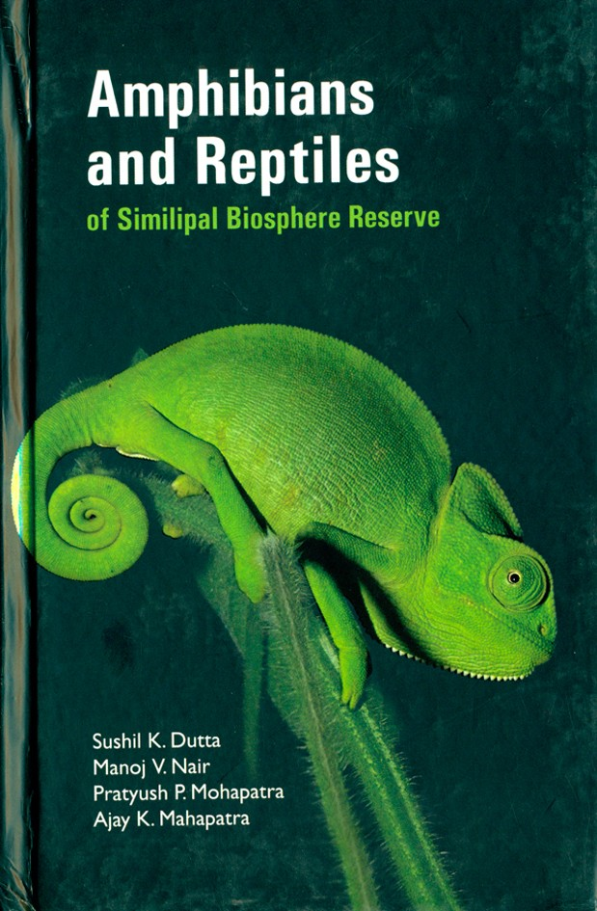
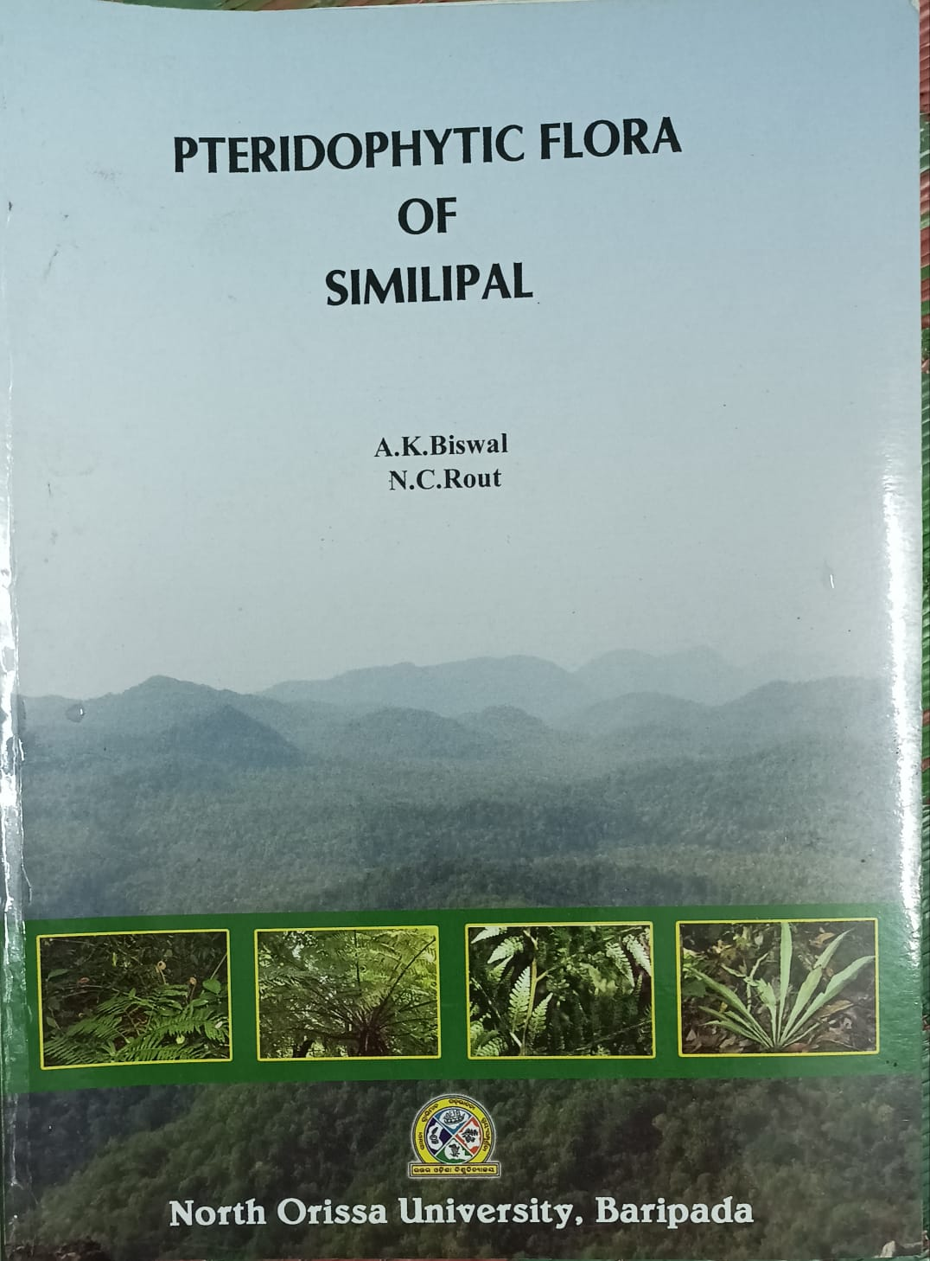
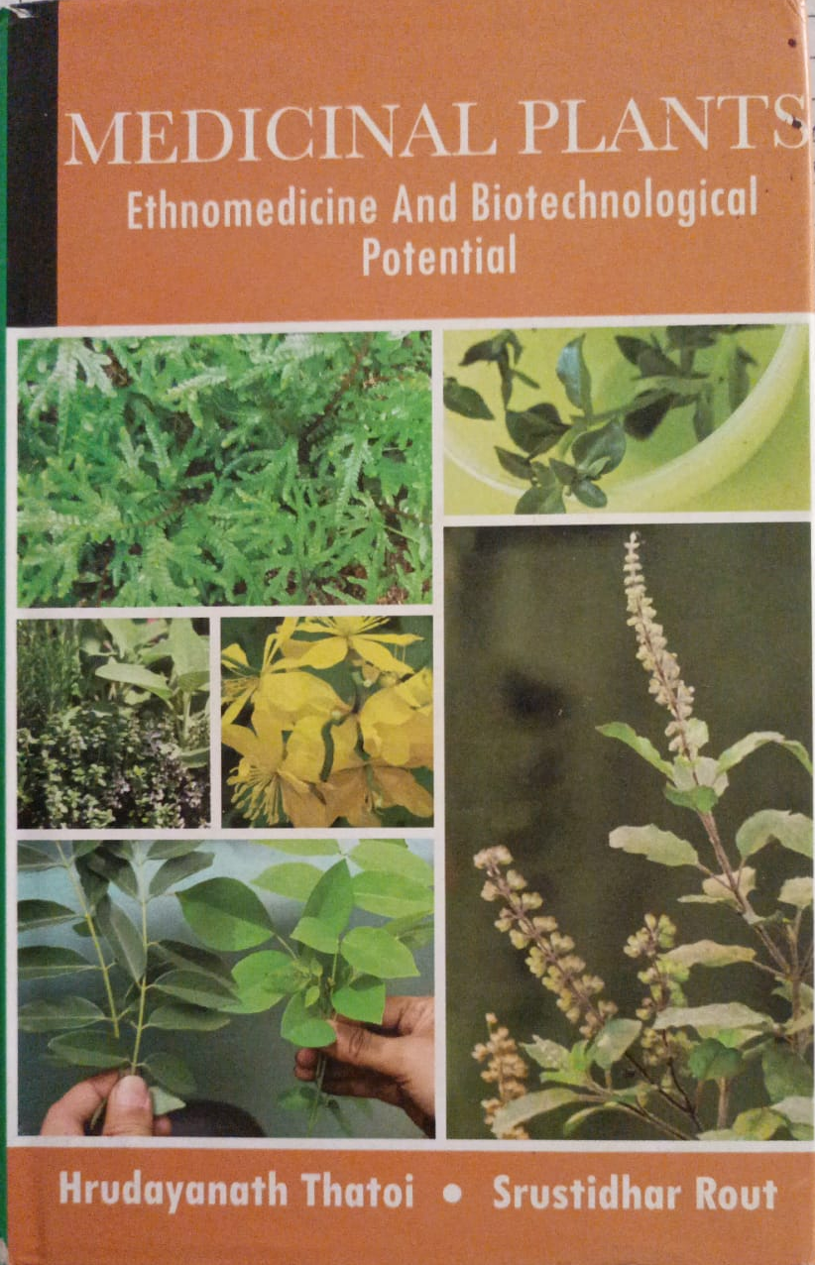
Remarkable publications on Similipal by faculty of MSCBU

Slide 12
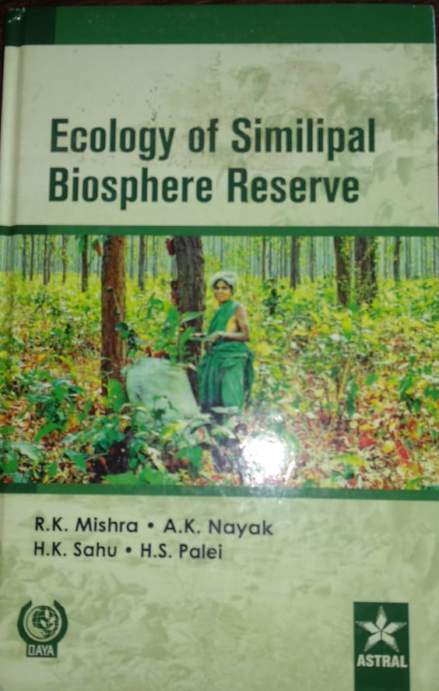
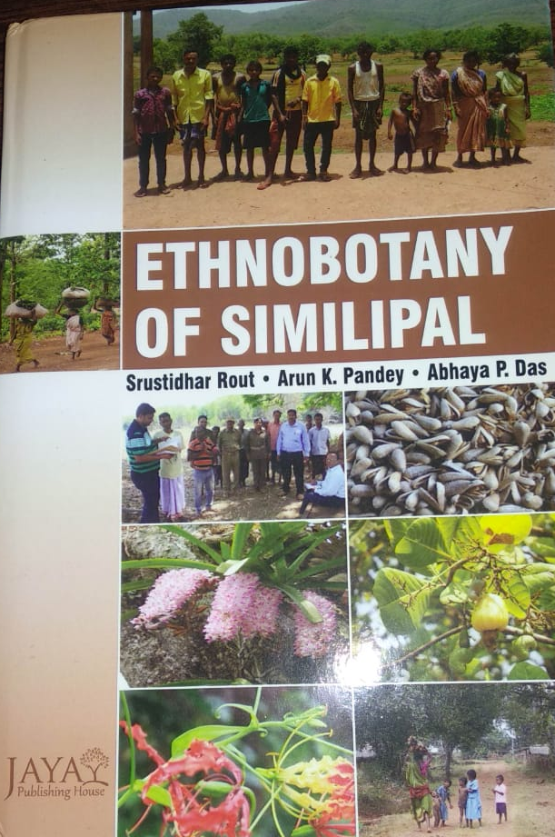

Slide 13
Research Publications->100
Animal Diversity- 25
Plant Diversity-15
Microbial diversity-02
Mushroom diversity-10
Lichen diversity-
Fern diversity-
Medicinal plant diversity-23
Ecology- 15
Ethnopharmacological properties of plants and animals-18
NTFP’s-2
Social Work- 2

Slide 14
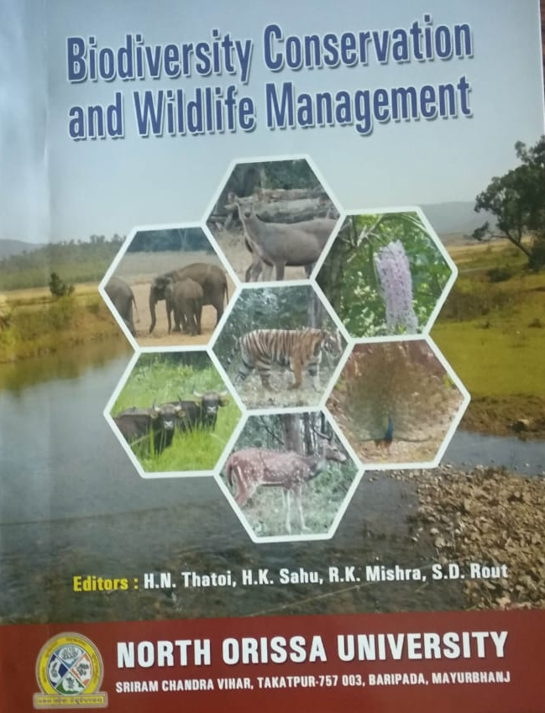
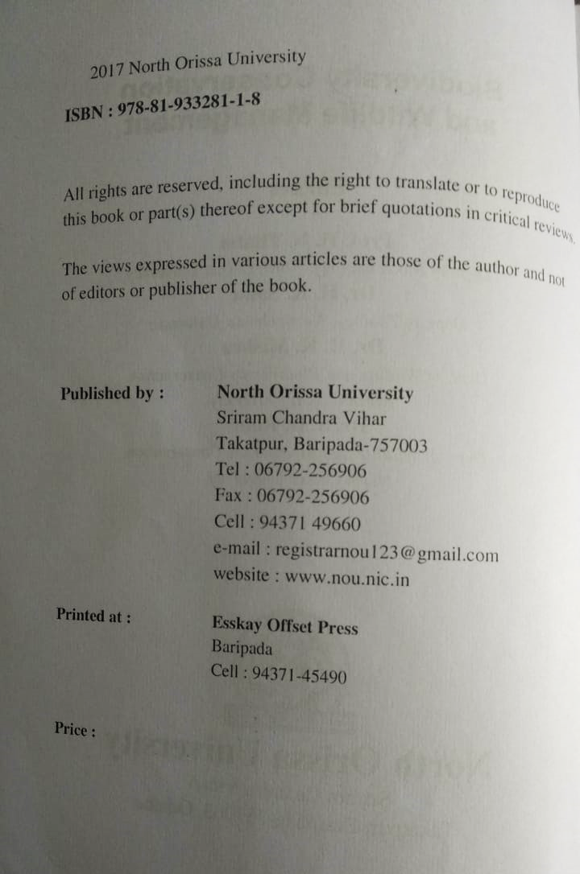
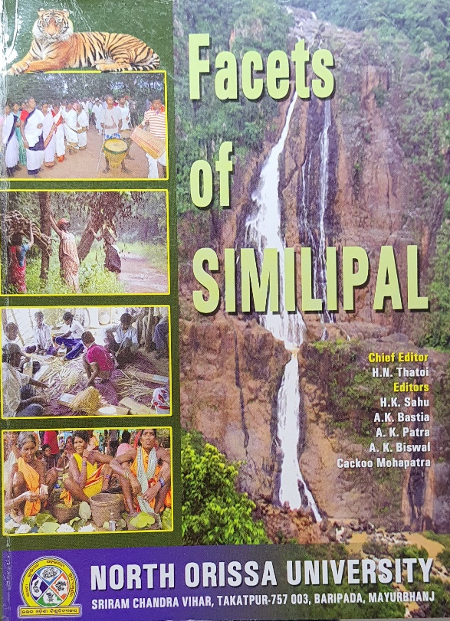
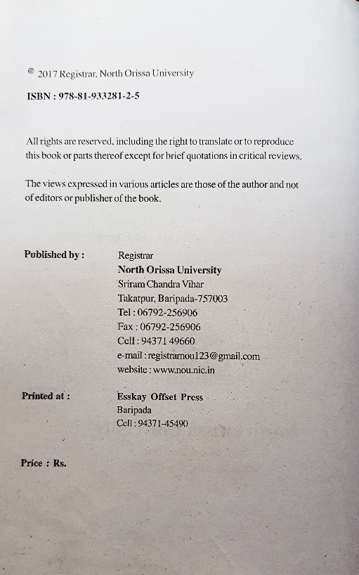
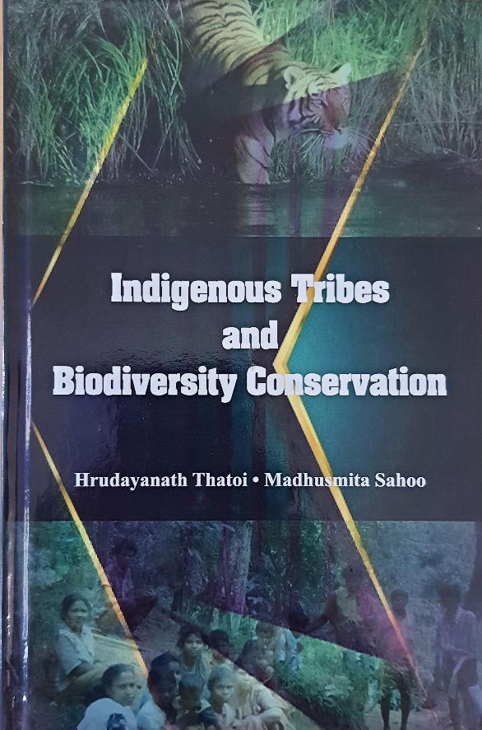
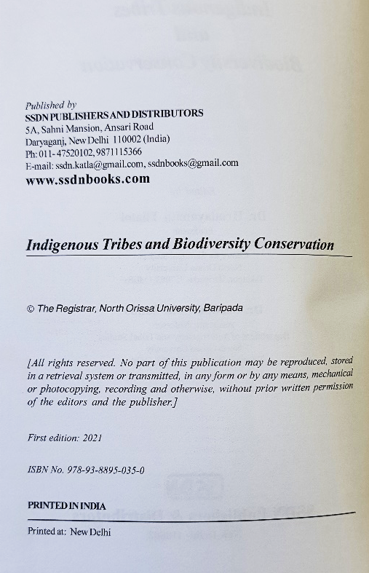
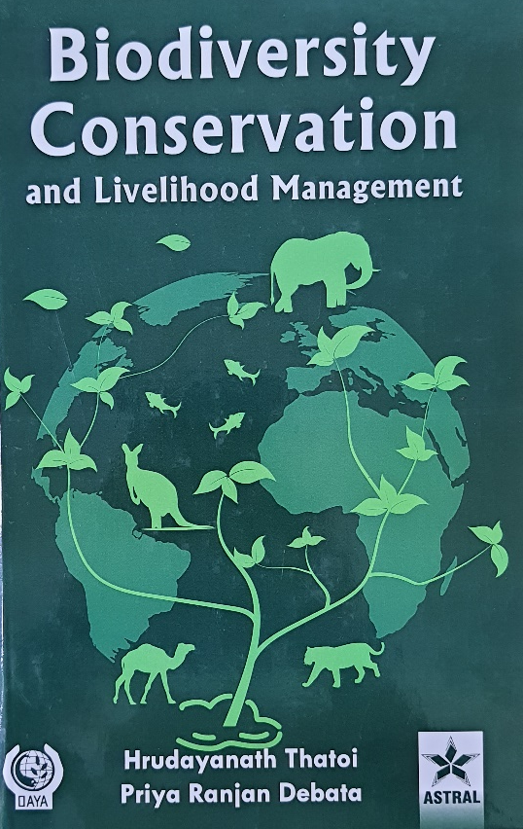
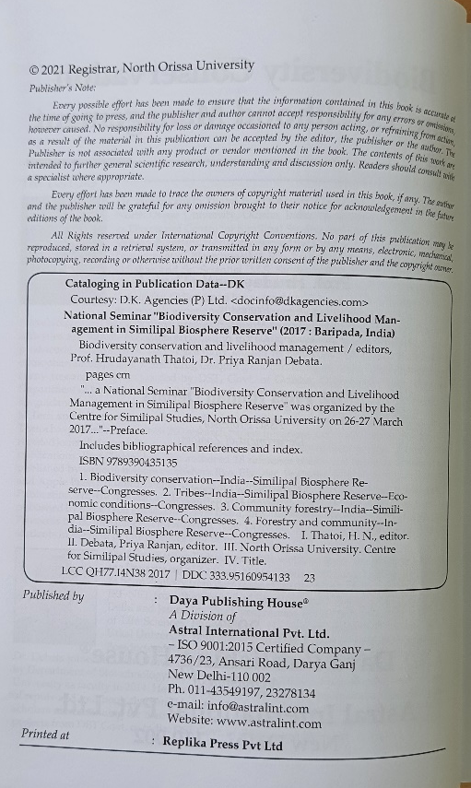
Books published

Slide 15
Seminars/Workshops/Training programmes Organized
National Seminar on “Similipal: Communities, Biodiversity and Conservation” organised by Centre for Similipal Studies (CSS), Maharaja Sriram Chandra Bhanja Deo University, Baripada in collaboration with Similipal Tiger Reserve, Forest Department, Govt of Odisha during 20th-21st December, 2021.
National Seminar on “Participation of Indigenous Tribes in Biodiversity Conservation” Organized by Center of Similipal Studies (CSS) in collaboration with Dept of Anthropology & Tribal Studies (ATS), North Orissa University during 21st and 22nd January, 2019.
National Seminar on “Biodiversity Conservation and Livelihood Management of Similipal Biosphere Reserve” organised by Centre for Similipal Studies (CSS) during March, 29-30, 2017.
National seminar on “Biodiversity of Similipal and Bird Watching” organised by organised by Centre for Similipal Studies (CSS) during March, 28-29, 2017.
2 day Workshop

Slide 16
Nearly 50% faculty members involved in CSS activities
Anthropology and Tribal Studies
Dr B. K. Mohanta, Dr M. Goswami, Dr P. Kar, Dr B. Sabar, Dr L. Sahoo
Biotechnology
Prof. H. N. Thatoi, Dr B. Rath
Botany
Dr K. L. Barik, Dr S. C. Sahu
Economics
Dr K. K. Sahu, Dr P.K. Jena
Zoology
Prof. H. K. Sahu, Dr P. Parida, Dr P. R. Debata, Dr G. Mohanty
WLBC
Dr S. Rout, Dr R. K. Mishra, Dr S. Rath, Dr D. Nayak, Dr A. Mallick
Social Work
Mr Suvendu Sathpathy
Computer Applications
Dr J. Mantri
RS and GIS
Dr Debabrata Nandi

Slide 17
Other activities undertaken by MSCBU regarding Similipal
NSS bureau- Forest fires
Donation of Winter clothes and blankets in the villages
Collaboration with BARC

Slide 18
Future Plans
Setting up an Institute of Similipal Biosphere Studies to supplement and support the ongoing research activities in the Similipal Biosphere Reserve by the Forest Department.
Infrastructure with state-of-the art laboratory facilities, Interpretation Centre and a model of Similipal Biosphere Reserve.
The Biosphere Reserve Action programme of SBR envisages a Research Committee and a Local Coordination Committee. The Institute can contribute significantly to both the Committees.
Adaptive research on climate change impacts on biodiversity and ecosystem.
Development of curriculum for Forest Department personnel for their scholarly development, quality upgradation and career advancement like Executive Ph.D., capacity development programmes for the front-line forest staff, certificate courses in Information Technology etc.
Curriculum may also be designed in consultation with the Forest Department.

